Slide 1
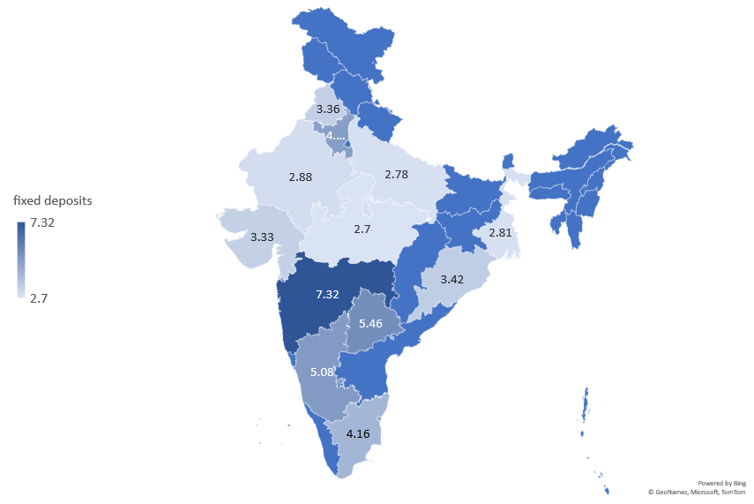
Avg. Fixed Deposit Investment In Lakhs

Slide 2
Interest Rate Changes

Slide 3
Bank Wise Interest Rates

